Slide 1
Deliverable 2
Mathew Anderson-Saavedrea N01436706
Nicole Chlea Manaoat N01565017
Medi Muamba Nzambi N01320883
Safah Virk N01596470

Slide 2
Team Name: TBD
Group 2
Project Name: Smart Library Study Room
Management and Comfort System

Slide 3
Demo of the App

Slide 4
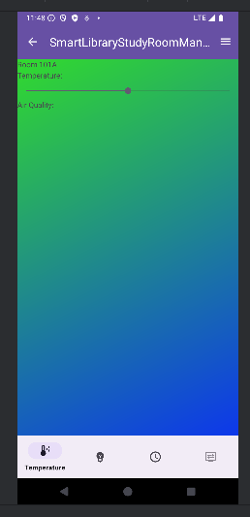
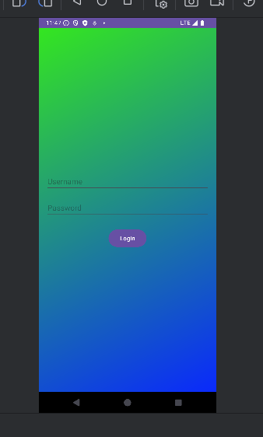
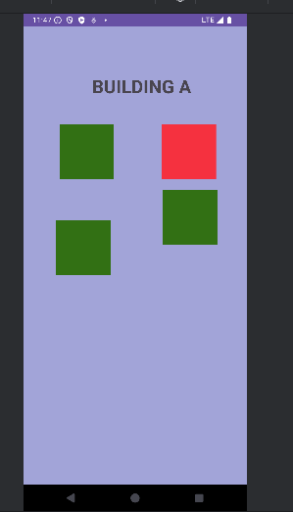
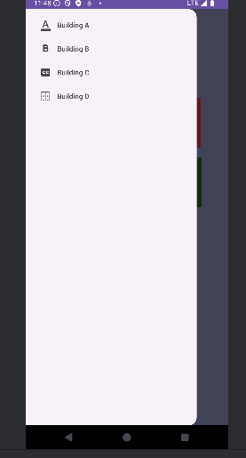
Screens & Flows

Slide 5
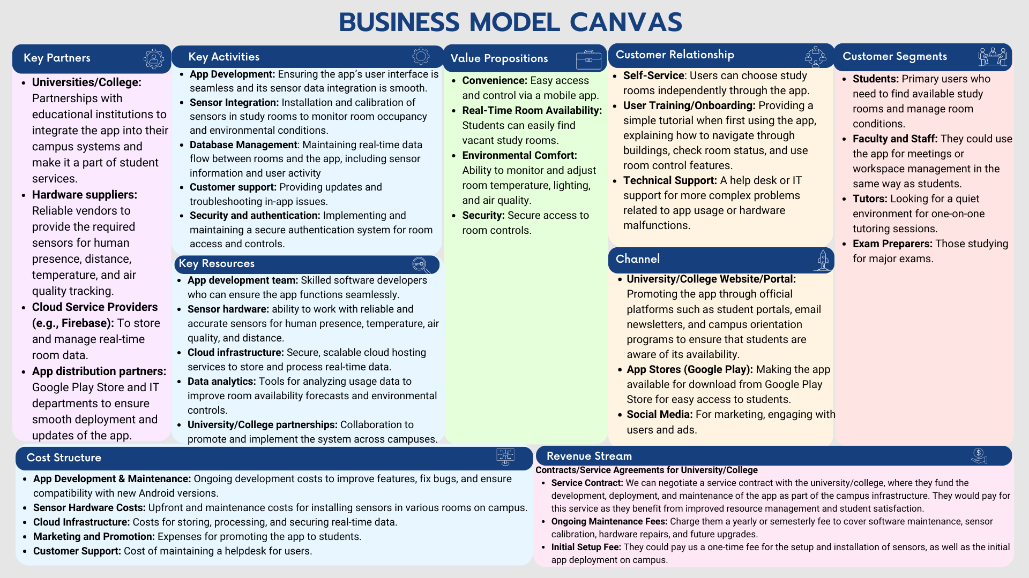
Business Model Canvas

Slide 6
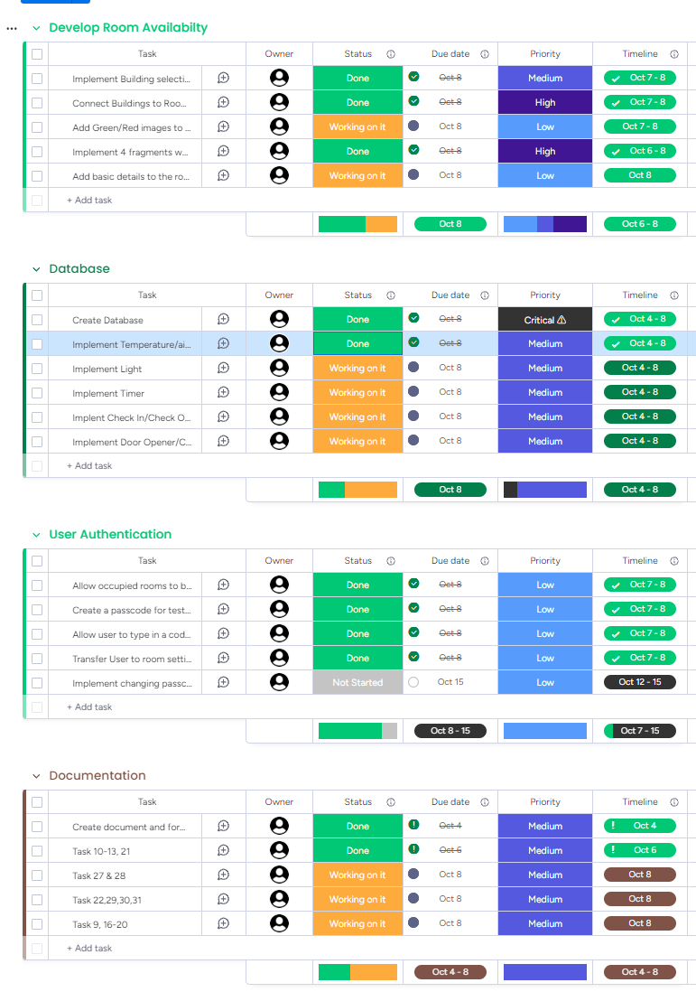
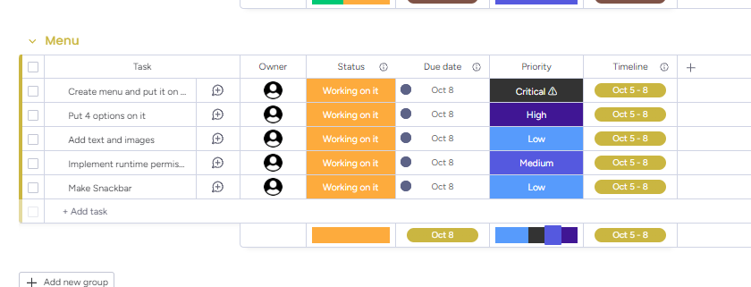
Sprint Dashboard

Slide 7
GitHub
1. Collaboration: This is the first thing to do. Someone of our members created a repository and invited us as collaborators. After this you can verify if the link is working.
2.Cloning the Repository: Each collaborator clones the repository using the repository link to get the existing files and code on our local machines.
3.Branching for Development: We create separate branches to start working on our individual tasks. This allows us to safely develop code without affecting the main codebase on the master/main branch. Each of us works within our own branch.

Slide 8
GitHub
4.Committing and Pushing Changes: Once we’ve made progress, we commit our changes and push them to our respective branches. Each branch only contains the changes specific to the work done by the individual team member.
5.Merging Changes to the Master/Main Branch: After development is complete, we need to merge the changes back into the master branch.
Method: Pull Request: We can create a pull request on GitHub. This is a request to merge our work into the master/main branch. A collaborator will review the changes and, if everything looks good, they or you can approve and confirm the merge. Once approved, the changes will be added to the master branch.
6.Getting Updates on the Local Machine: Once the changes are merged into the master/main branch, you may want to pull the latest changes to your local machine. In Android Studio, this can be done by clicking on the Git menu and selecting Pull or Update Project. This ensures your local code is in sync with the latest version on GitHub.

Slide 9
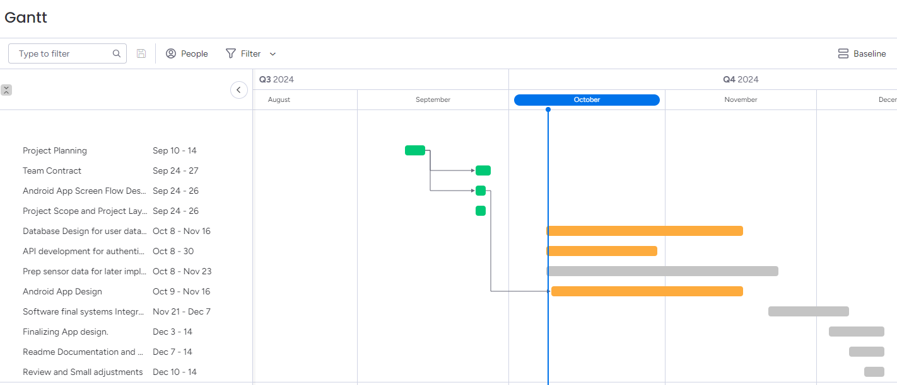
Gantt Chart Summary

